Slide 1
Version control concepts & GIT Basics
Notes:
https://courses.cs.washington.edu/courses/cse403/13au/lectures/git.ppt.pdf
http://enos.itcollege.ee/~jpoial/allalaadimised/git/getting-started-with-git.pdf

Slide 2

Why Do We Need A Version Control System (VCS)?
Backup and Restore
Synchronization
Undo
Track Changes
Track Ownership
Sandboxing
Branching and merging
Notes:
https://betterexplained.com/articles/a-visual-guide-to-version-control/

Slide 3
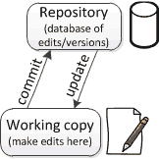
Repositories and working copies
Working copy
Personal copy of all the files.
We changes this copy, without affecting our teammates.
A repo/repository is
A database of all the edits and historical versions (snapshots) of project.
Commit changes to repo
When we are happy with changes

Slide 4
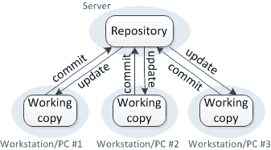
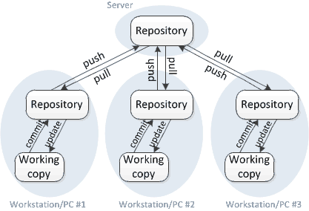
Centralized vs Distributed version control
Subversion/CVS - Just one repository
Central server is must.
Spoke and hub structure
Local changes are not versioned
Need to communicate with server at each check in/ checkout.
GIT/ Mercurial - Multiple repositories
Can be used Offline
Full history of repository lives on every user’s machine
Peer to Peer model
Many operations are local

Slide 5
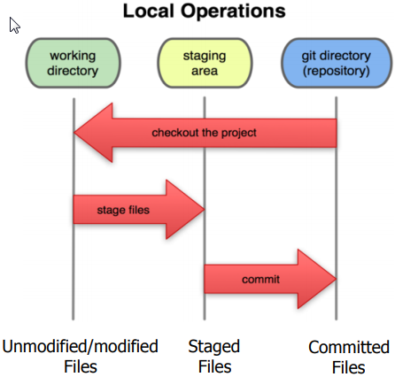
Local git operations
1
2
3

Slide 6

Terminology
Repository
The database storing the files.
Server
The computer storing the repo.
Client
The computer connecting to the repo.
Working Copy
Our local directory of files, where we make changes.
Master
The repository’s main branch.
Clone
Copies an existing git repository, normally from some remote location to local environment.
Commit
Submitting files to the repository (the local one); in other VCS it is often referred to as “checkin”
Notes:
https://dzone.com/articles/intro-git

Slide 7
Terminology
fetch or pull
Is like “update” or “get latest” in other VCS.
Push
Used to submit the code to a remote repository
Remote
“remote” locations of repository, normally on some central server.
SHA
Every commit or node in the Git tree is identified by a unique SHA key.
Head
Is a reference to the node to which our working space of the repository currently points.
Branch
A particular label on a given node.
Notes:
https://dzone.com/articles/intro-git

Slide 8

Workstation Setup
Visit
git-scm.com/downloads.
Detailed information
http://git-scm.com/book/en/Getting-Started-Installing-Git
First thing
git config --global user.name “My Name"
git config --global user.email myemail@gmail.com
Notes:
#Get the details of current config
git config --global user.name
git config --global user.email
git config --global user.name "My Name"
git config --global user.email myemail@gmail.com
#get current working directory
pwd
mkdir mygitrepo
cd mygitrepo
git init
git status
touch hello.txt
echo Hello, world! > hello.txt
git add hello.txt
git status
git commit -m "Add my first file"
#now do changed in the file - hello.txt again and run below command
vim hello.txt
git status
git add hello.txt
git status
git diff --staged
git commit -m "Add my file to staged"
git log
git log --since=yesterday
git log --since=2weeks
# now do the changes in working directory
vim hello.txt
# Optionaly stage the changes before git reset --hard
git add hello.txt
# Below command will remove any changes done and replace the contents of workinf directory from last commit
git reset --hard
#To view the statistics and facts about the last commit:
git show
# come out of current working directory and lets clone the repository from GitHuib
git clone https://github.com/leereilly/hello-world-java.git
cd hello-world-java
#The full address of that remote can be viewed with:
git remote -v
# push local repository to remote
git push origin master
# pull from remote to local repository
git pull

Slide 9

Let’s get started: Create a new Git Repository
Create a new directory
mkdir mygitrepo
cd mygitrepo
Initialize repository
git init
Check status of repository
git status
Create and commit file
$ touch hello.txt
$ echo Hello, world! > hello.txt

Slide 10
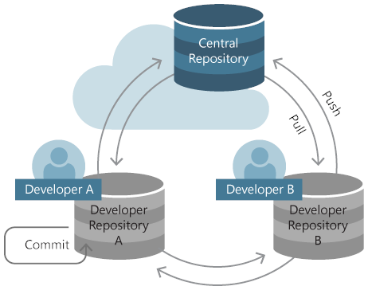
Lets get started: Create a new Git Repository
“register” the file for committing
$ git add hello.txt
Check status
$ git status
# On branch master
#
# Initial commit
#
# Changes to be committed:
# (use "git rm --cached <file>..." to unstage)
#
# new file: hallo.txt
#

Slide 11
Lets get started: Create a new Git Repository
Commit
$ git commit -m "Add my first file"

Slide 12
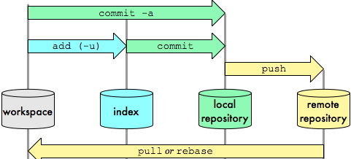

Slide 13
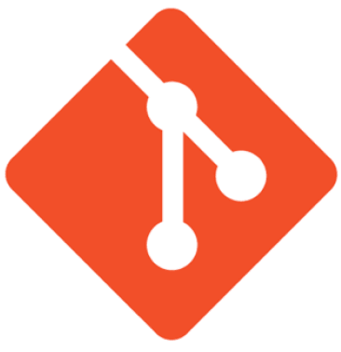
Git commands
Command | Description
git clone url [dir] | Copy a Git repository so we can add to it
git add file | Adds file contents to the staging area
git commit | Records a snapshot of the staging area
git status | View the status of our files in the working directory and staging area
git diff | Shows diff of what is staged and what is modified but unstaged
git help [command] | Get help info about a particular command
git pull | Fetch from a remote repo and try to merge into the current branch
git push | Push our new branches and data to a remote repository

Slide 14
CLONING EXISTING PROJECTS
Syntax
git clone https://github.com/atingupta2005/hello-world.git
Clone performs several subtasks:
Sets up a remote named origin that points to the location
http://github.com/matthewmccullough/hellogitworld.git
Asks this location for the contents of its entire repository
Git copies those objects to the requestor’s local disk
Switches to a branch named master
Ready
The local copy of this repo is now ready to have edits made, branches created, and commits issued – all while online or offline.

Slide 15
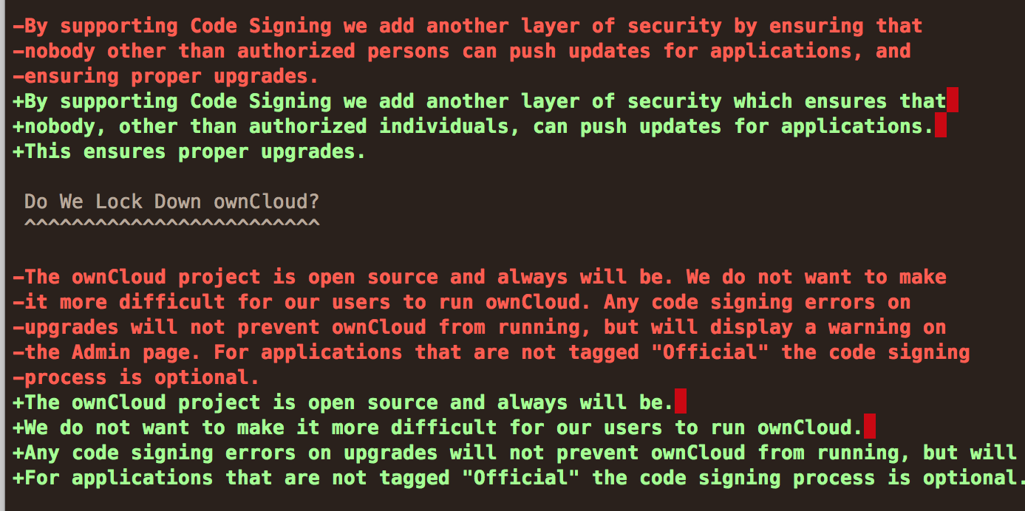

DIFF
Difference between edited and committed files
git diff

Slide 16
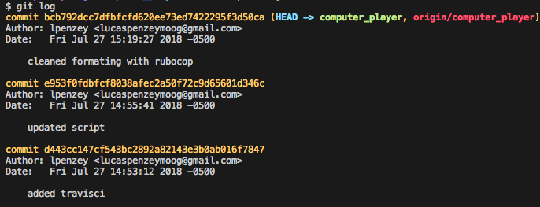
LOG
List of changes
git log
git log --since=yesterday
git log --since=2weeks

Slide 17
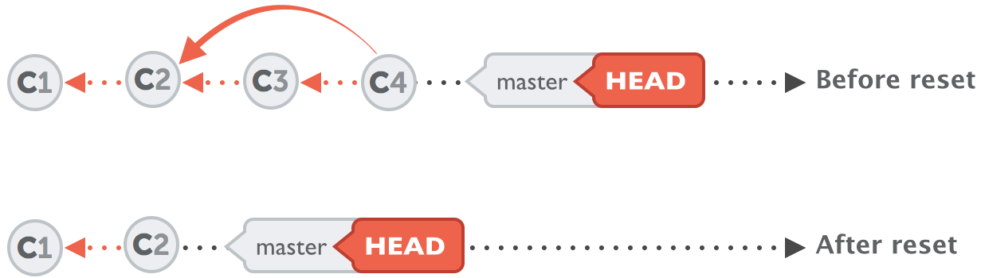
ABORTING
Abort current uncommitted changes
git reset --hard
Notes:
To target just one file, use the checkout command.
git checkout -- Person.java

Slide 18

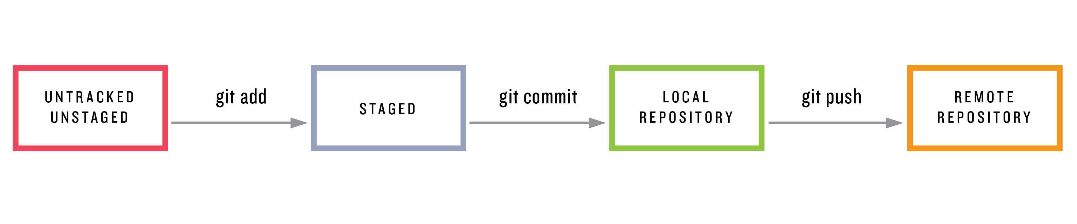
ADDING (STAGING)
To put files into next commit
git add .
1
2
3

Slide 19
COMMITTING
Save pending additions to local repository
git commit –m “<commit message>”
To view the statistics and about last commit:
git show
1
2
3

Slide 20
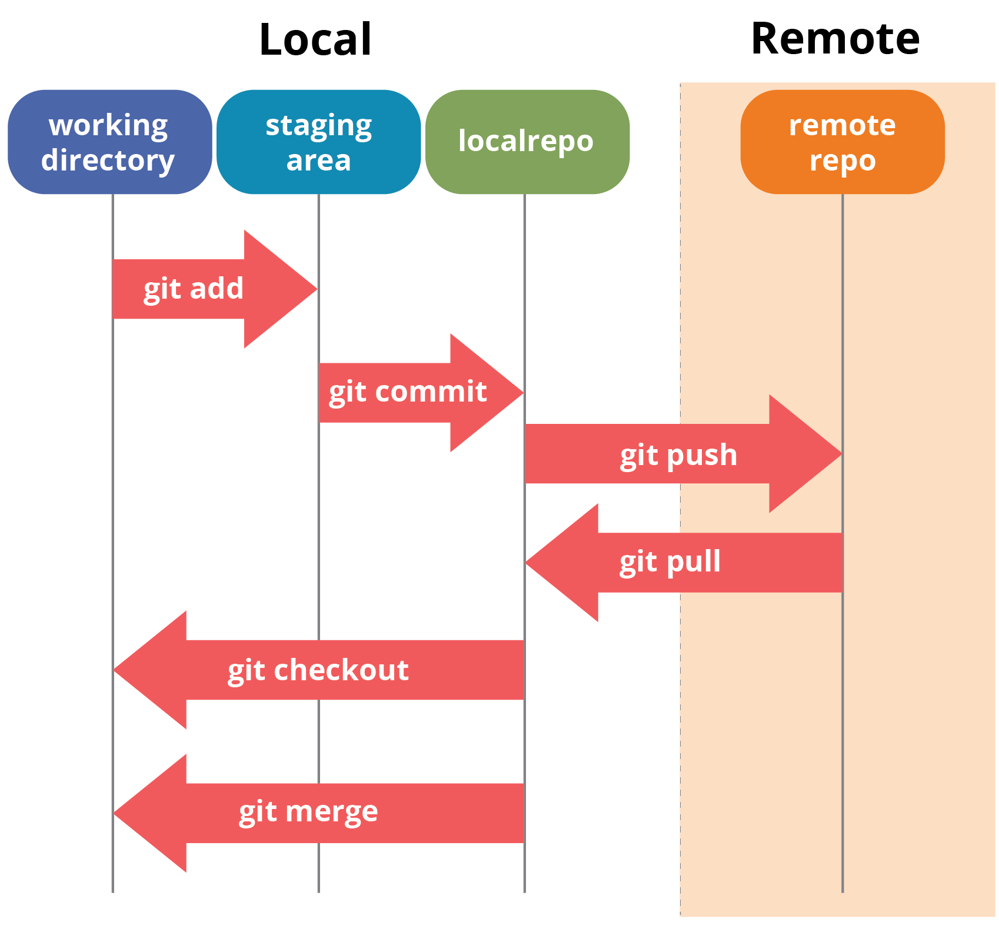
PUSH / PULL
To put changes from local repo in the remote repo
git push origin master
From remote repo to get most recent changes
git pull <remote name> <branch name>

Slide 21

GitHub.com
For online storage of Git repositories
Can create a remote repo there and push code to it
Free space for open source projects
Its not mandatory to use Github to use Git.
We can use Git locally for our own purposes.
We can also set up a git server locally

Slide 22


